Slide 1

Part I (Summary):
MF Recommendation Retrieval as Similarity Search Problem

Slide 2
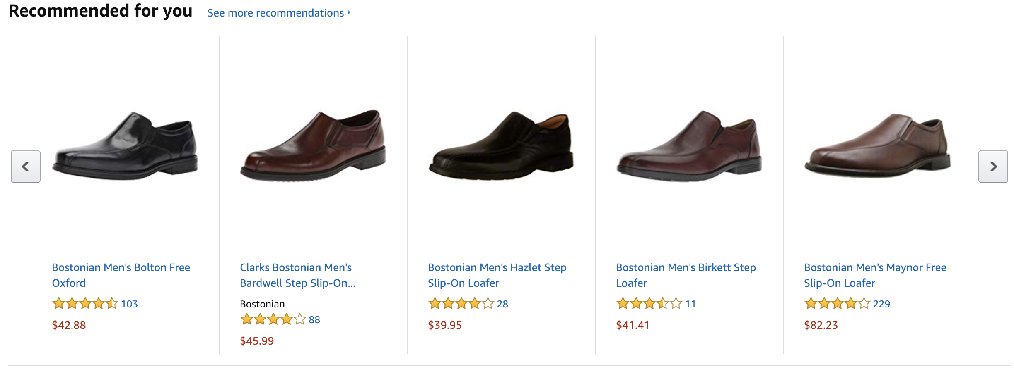

Solution: Recommender Systems

Slide 3















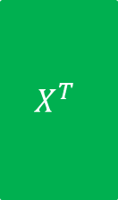










Two Phases of a MF Recommender System
$$n$$
$$d$$
$$n$$
$$R$$
$$X^{T}$$
$$Y$$
Learning
phase
$$m$$
$$≈$$
$$m$$
$$×$$
$$d$$
$$n$$
$$pref_{u}\left(i\right)=x_{u}^{T}{.y}_{i}$$
$$d$$
$$Y$$
$$n$$
$$×$$
$$d$$
$$=$$
$$pref_{u}$$
$$1$$
$$x_{u}$$
$$1$$
Retrieval
phase
$$n$$
Top-K items
$$1$$
Sorted $pref_{u}$

Slide 4
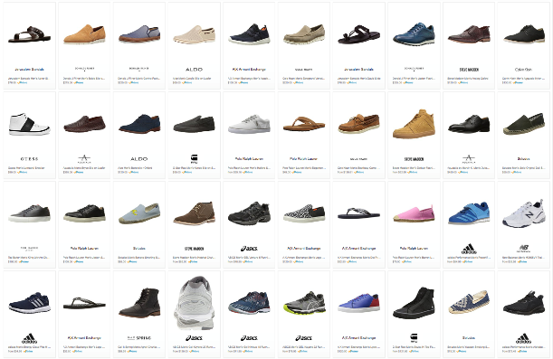
Choice Explosion
133,520 results for ”Men’s Shoes"

Slide 5
Scalable Recommendation Retrieval
Linear scanning may not be scalable for real-time retrieval
Indexing schemes do not work out-of-the-box for Maximum Inner Product Search (MIPS)
Strategy #1: Approximate MIPS
Learn the latent vectors from matrix factorization as usual
Apply post-hoc treatment or transformations to those vectors to enable approximation
Strategy #2: Indexable Representation
Design new matrix factorization techniques that would output natively indexable latent vectors
Compatible with LSH, spatial trees, or inverted index
Strategy #3: Discrete Representation
Learn a different representation altogether, e.g., binary codes
Inherently compatible with Hamming ranking or hashtable lookup

Slide 6
Part II B:
Approaches for Scalable Recommendation Retrieval
Indexable Representation
Slides available at
https://code.preferred.ai/recommendation-retrieval

Slide 7
Indexable Representation
Conventional matrix factorization (MF) generates representations incompatible with indexing as it relies on max. inner product search
LSH relies on Euclidean distance or cosine similarity
Spatial index relies on Euclidean distance
Inverted index relies on cosine similarity
Previous strategy:
apply postprocessing or transformation to representations from MF
Pro: no need to re-learn the representations
Con: fixed representations may constrain post-transformation performance
Why not learn representations that are compatible with indexing in the first place?

Slide 8
Approaches towards Indexability
Euclidean Embedding
Indexable MF
Change inner-product formulation to one based on Euclidean distance
Compatible with spatial index and L2LSH
Keep inner-product formulation, but ensure native indexability
Compatible with spatial index, L2LSH, SRP-LSH, inverted index

Slide 9
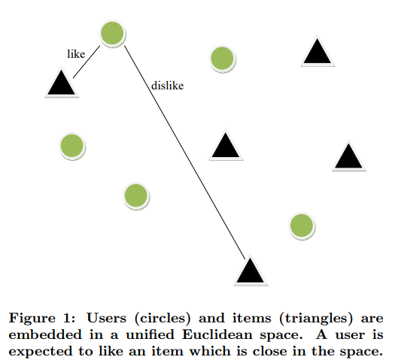
Approach #1: Euclidean Embedding
Khoshneshin and Street, "Collaborative Filtering via Euclidean Embedding”, RecSys 2010.
Users and items represented as coordinates in the same D-dimensional space
The smaller the distance between a user and an item, the more the user likes the item

Slide 10
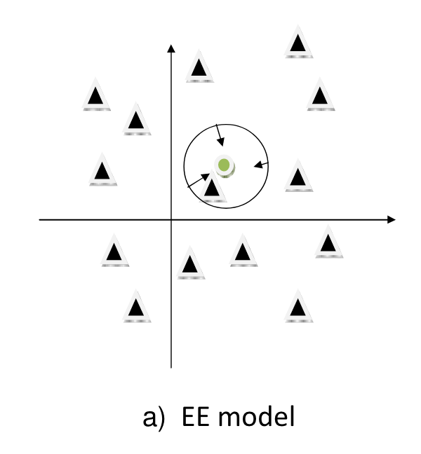
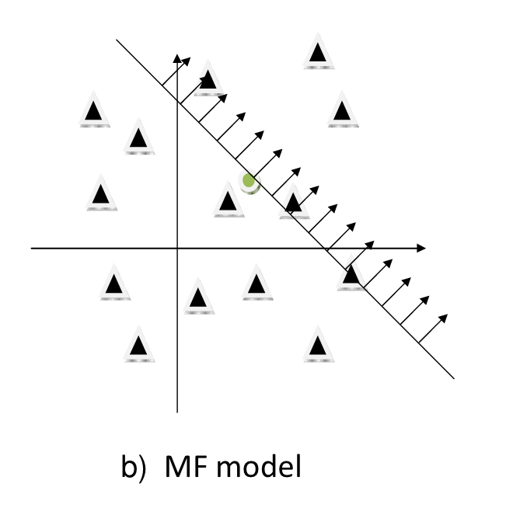


Euclidean Embedding for Explicit Feedback
Khoshneshin and Street, "Collaborative Filtering via Euclidean Embedding”, RecSys 2010.
Euclidean Embedding
Matrix Factorization
$${\hat{r}}_{ui}=μ+b_{u}+b_{i} −{\left|\left|x_{u} −y_{i}\right|\right|}^{2}$$
$${\hat{r}}_{ui}=μ+b_{u}+b_{i}+x_{u}^{T}y_{i}$$

Slide 11
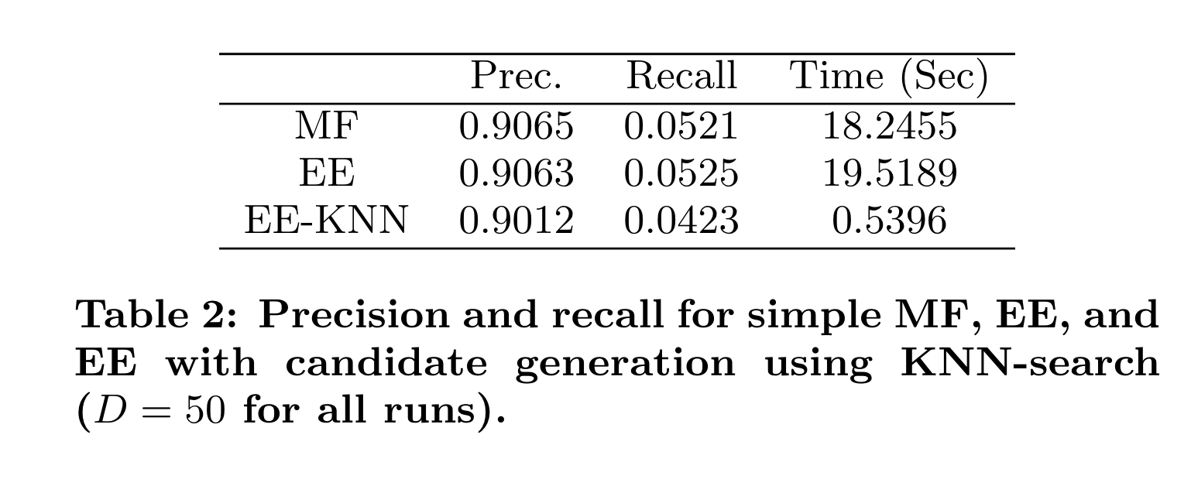
Euclidean Embedding for Explicit Feedback
Khoshneshin and Street, "Collaborative Filtering via Euclidean Embedding”, RecSys 2010.
Euclidean Embedding
Matrix Factorization
$${\hat{r}}_{ui}=μ+b_{u}+b_{i} −{\left|\left|x_{u} −y_{i}\right|\right|}^{2}$$
$${\hat{r}}_{ui}=μ+b_{u}+b_{i}+x_{u}^{T}y_{i}$$

Slide 12
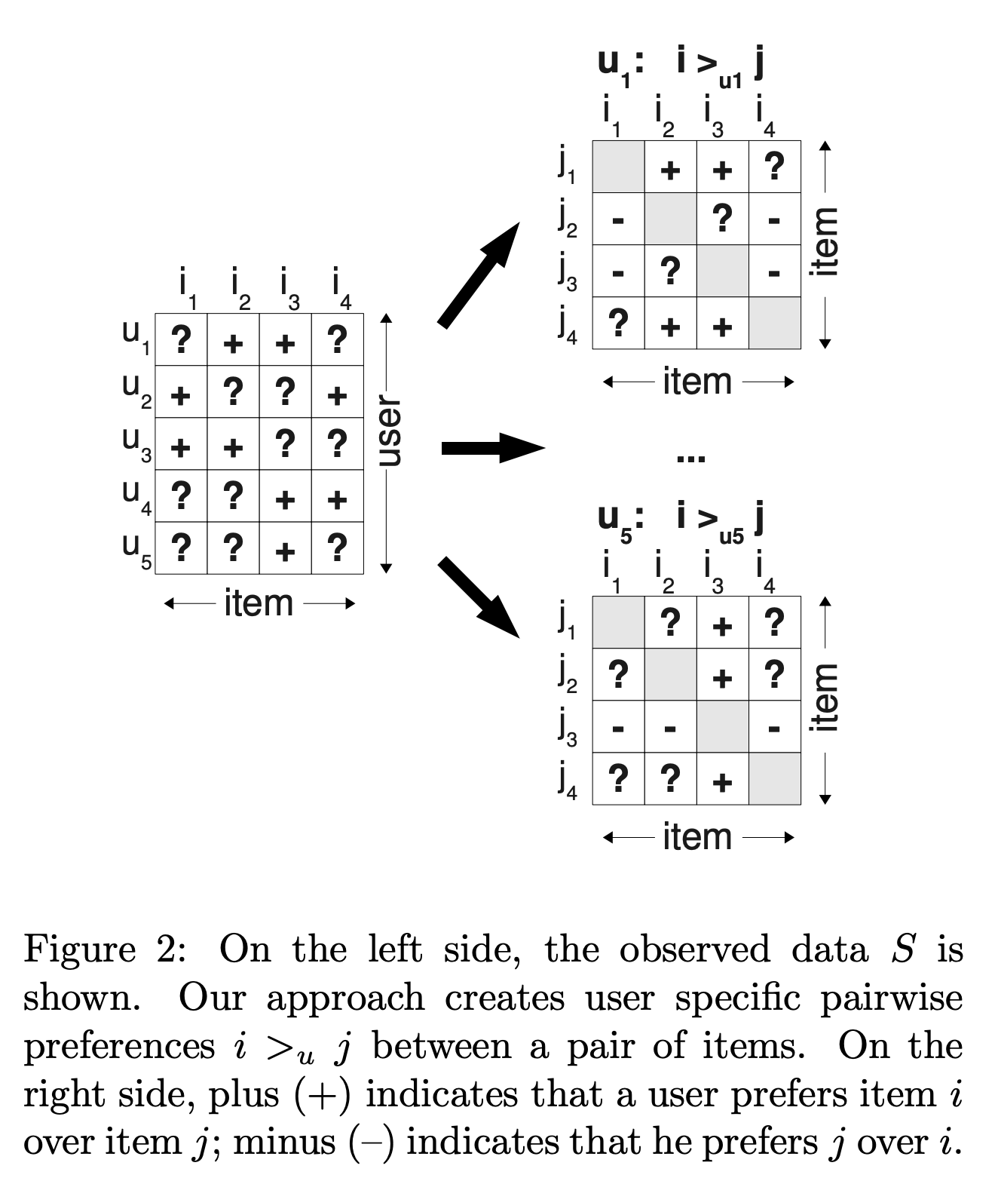
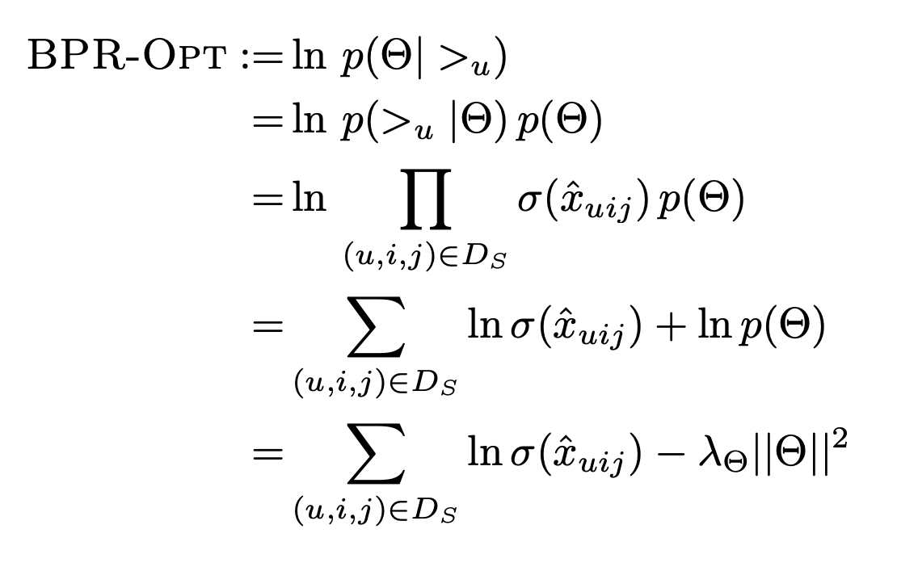
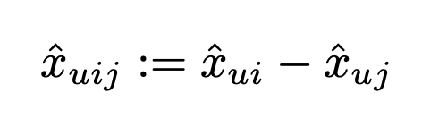
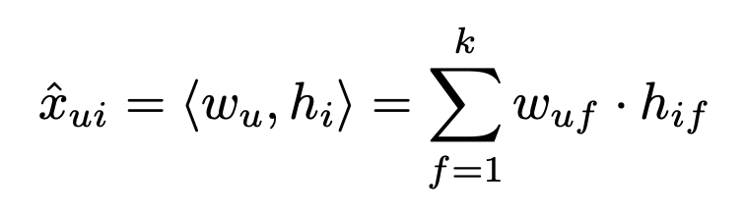
Matrix Factorization for Implicit Feedback
Salakhutdinov and Mnih, "BPR: Bayesian Personalized Ranking from Implicit Feedback", UAI 2009

Slide 13
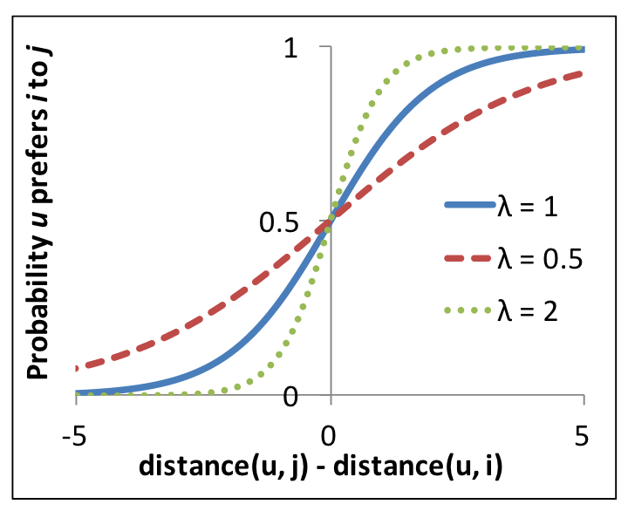
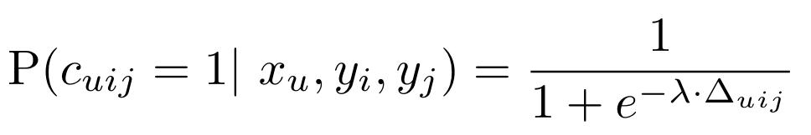
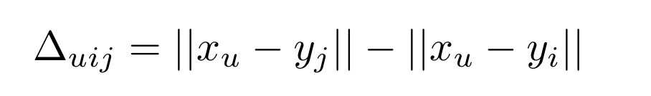
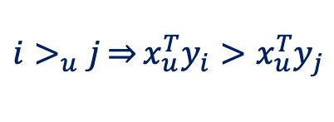
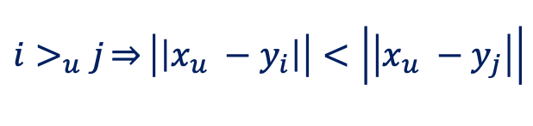
Euclidean Embedding for Implicit Feedback
Le and Lauw, "Euclidean Co-Embedding of Ordinal Data for Multi-Type Visualization", SDM 2016.
Euclidean Embedding
Matrix Factorization
$${i>}_{u}j\overset{⇒}{}\left|\left|x_{u} −y_{i}\right|\right|<\left|\left|x_{u} −y_{j}\right|\right|$$
$${i>}_{u}j\overset{⇒}{}x_{u}^{T}y_{i}>x_{u}^{T}y_{j}$$

Slide 14
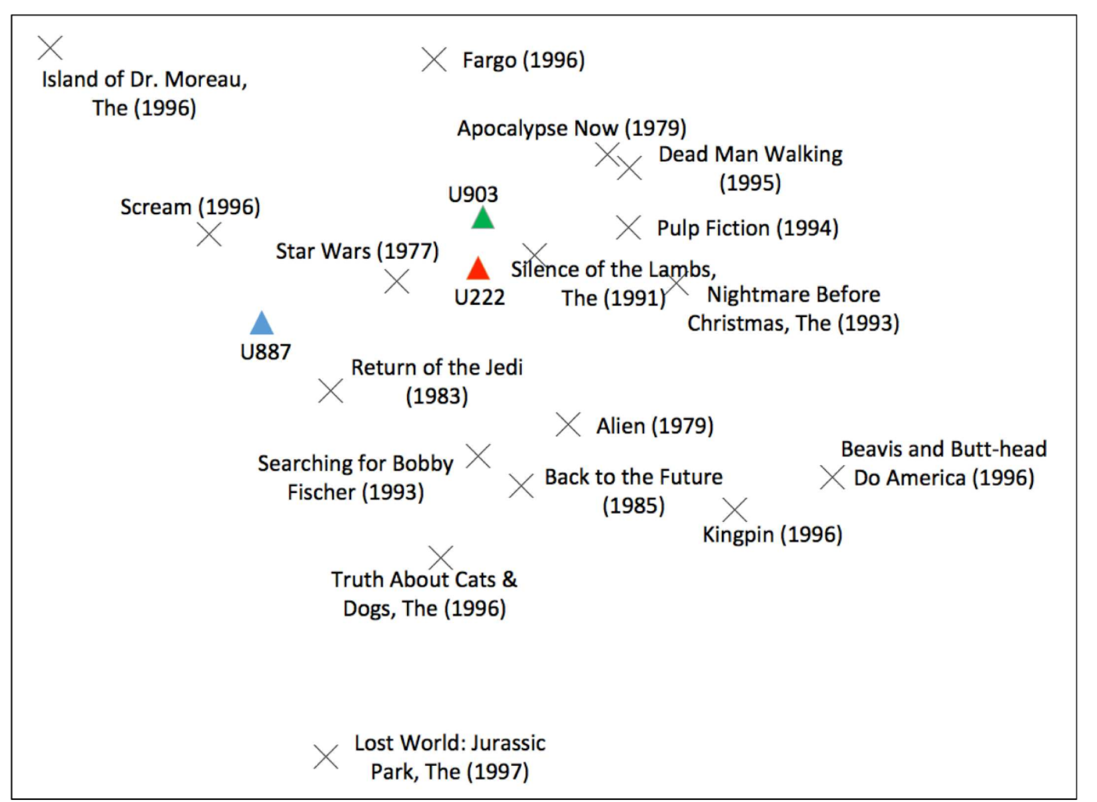
Visualization via Euclidean Embedding
Le and Lauw, "Euclidean Co-Embedding of Ordinal Data for Multi-Type Visualization", SDM 2016.

Slide 15
Approaches towards Indexability
Euclidean Embedding
Indexable MF
Change inner-product formulation to one based on Euclidean distance
Compatible with spatial index and L2LSH
Keep inner-product formulation, but ensure native indexability
Compatible with spatial index, L2LSH, SRP-LSH, inverted index

Slide 16




Nearest Neighbor Search
Nearest Neighbor Search (NNS)
Maximum Inner Product Search
(MIPS)
$$\underset{i}{argmin}{{(\left\|x_{u}−y_{i}\right\|}^{2})}$$
$$\underset{i}{argmax}{{(x}_{u}^{T}{.y}_{i})}{}$$
$$\underset{i}{=argmin}{({\left(x_{u}−y_{i}\right)}^{T}(x_{u}−y_{i}))}$$
$$\underset{i}{=argmin}{{(\left\|x_{u}\right\|}^{2}+{\left\|y_{i}\right\|}^{2}−2{(x}_{u}^{T}{.y}_{i}))}$$
When the norm of item vectors is constant, NNS is equivalent to MIPS

Slide 17


Maximum Cosine Similarity Search
Maximum Cosine Similarity Search
(MCSS)
Maximum Inner Product Search
(MIPS)
$$\underset{i}{argmax}{(\frac{x_{u}^{T}{.y}_{i}}{\left\|x_{u}\right\|\left\|y_{i}\right\|})}$$
$$\underset{i}{argmax}{{(x}_{u}^{T}{.y}_{i})}{}$$
When the norm of item vectors is constant, MCSS is equivalent to MIPS

Slide 18
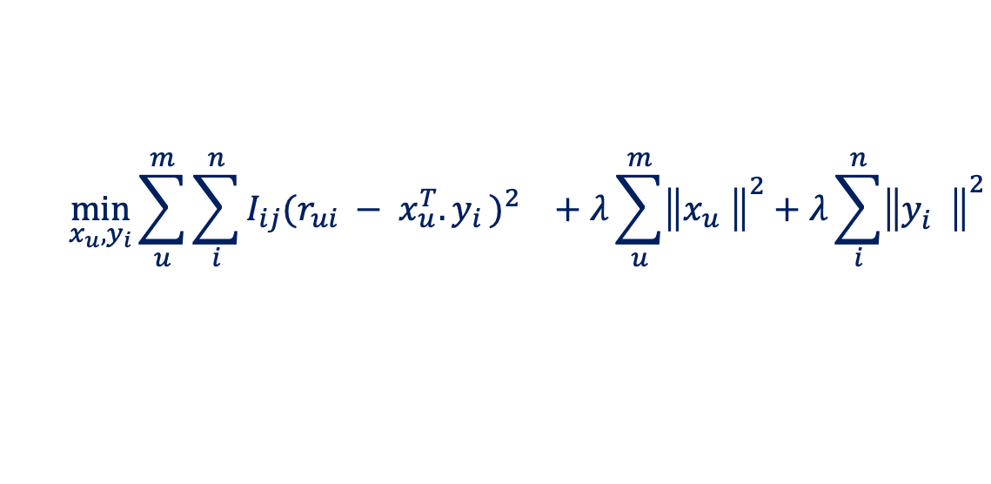


Indexable MF for Explicit Feedback
Fraccaro, Paquet, and Winther, "Indexable Probabilistic Matrix Factorization for Maximum Inner Product Search", AAAI 2016.
$$n$$
$$d$$
$$n$$
$$R$$
$$X^{T}$$
$$Y$$
$$m$$
$$≈$$
$$m$$
$$×$$
$$d$$
Prediction
$${pref}_{u}\left(i\right)=x_{u}^{T}{.y}_{i}$$
Learning Objective
$$\min_{x_{u}, y_{i}}{\sum_{u}^{m}{\sum_{i}^{n}{I_{ij}{{(r_{ui} − x_{u}^{T}{.y}_{i})}^{2}}_{}}+λ\sum_{u}^{m}{{\left\|x_{u}^{}\right\|}^{2}}+λ\sum_{i}^{n}{{\left\|y_{i}^{}\right\|}^{2}}}}{}$$
Constraint
$$s.t. \left|\left|y_{i}\right|\right|=c ∀ 1≤i≤n.$$

Slide 19
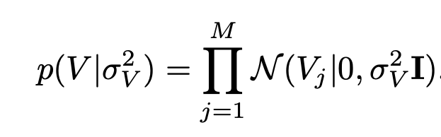
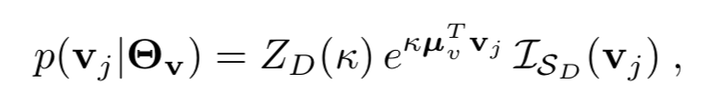
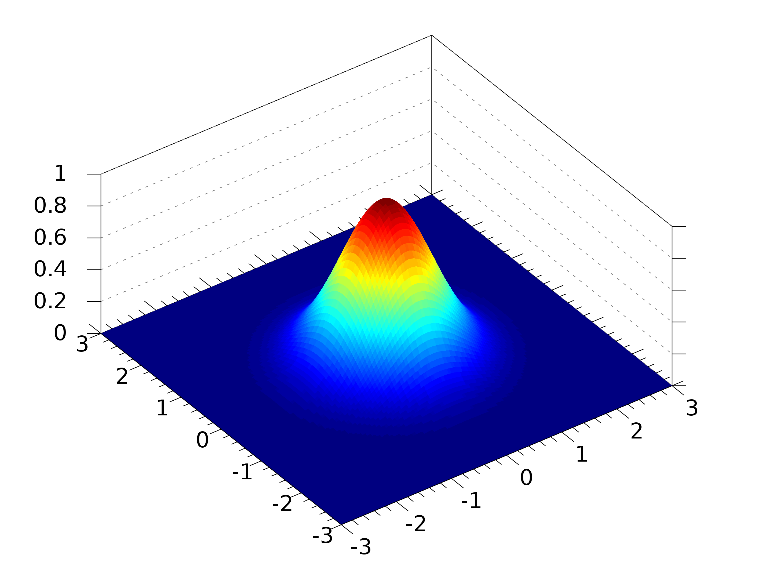
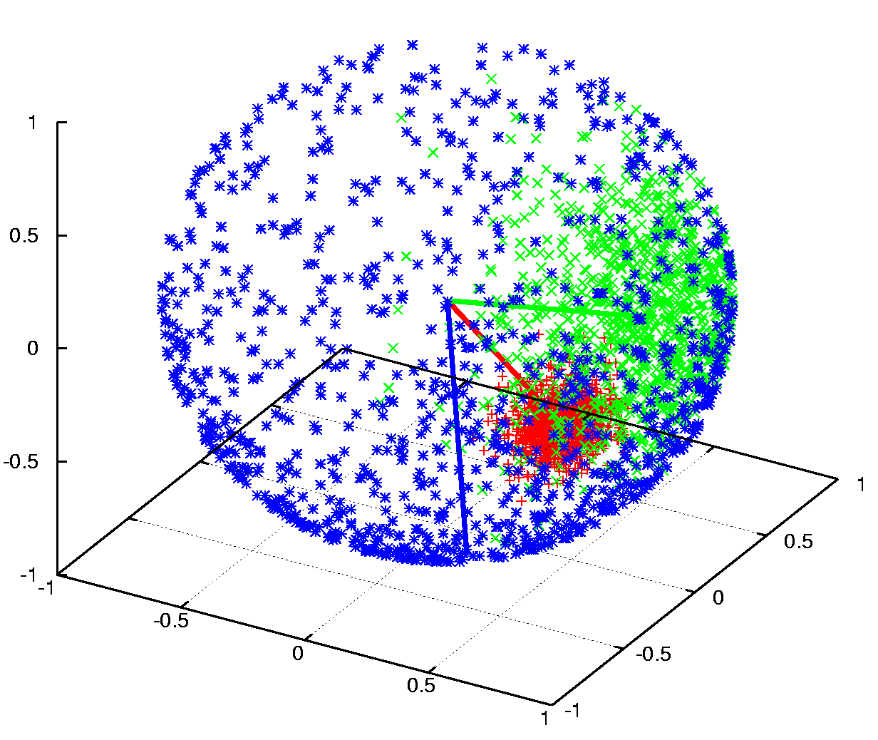
Indexable MF for Explicit Feedback
Fraccaro, Paquet, and Winther, "Indexable Probabilistic Matrix Factorization for Maximum Inner Product Search", AAAI 2016.
Probabilistic Matrix Factorization (PMF)
Indexable Probabilistic Matrix Factorization (PMF)
Item prior is drawn from Gaussian distribution
Item prior is drawn from spherical Von Mises-Fisher (vMF) distribution

Slide 20
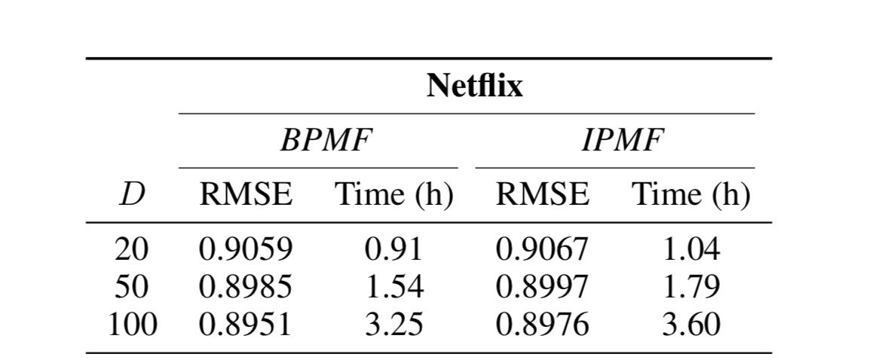
Indexable MF for Explicit Feedback
Fraccaro, Paquet, and Winther, "Indexable Probabilistic Matrix Factorization for Maximum Inner Product Search", AAAI 2016.
BPMF and IPMF are structurally similar,
except in their conditional distributions of the item vectors.

Slide 21
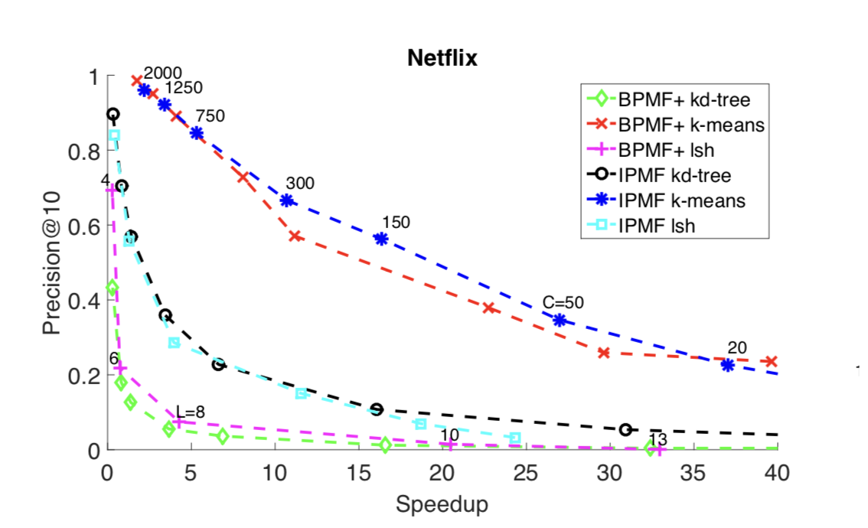
Indexable MF for Explicit Feedback
Fraccaro, Paquet, and Winther, "Indexable Probabilistic Matrix Factorization for Maximum Inner Product Search", AAAI 2016.

Slide 22
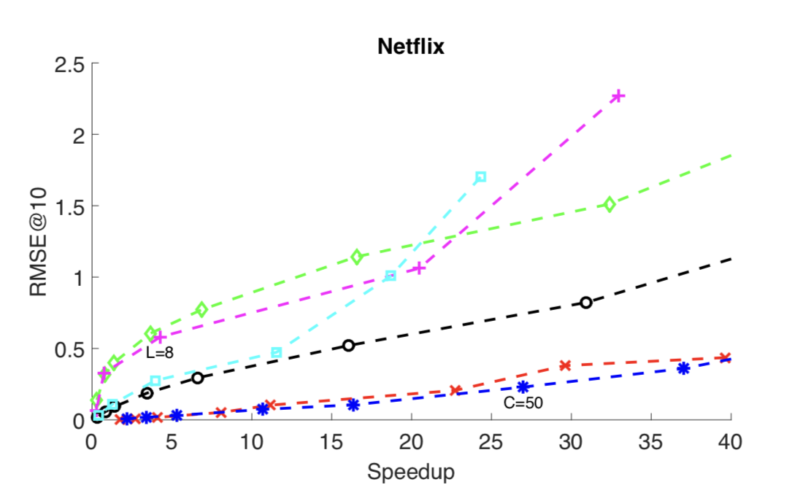
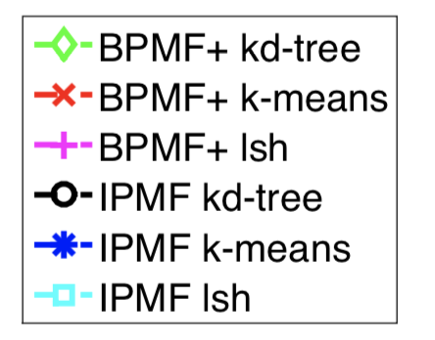
Indexable MF for Explicit Feedback
Fraccaro, Paquet, and Winther, "Indexable Probabilistic Matrix Factorization for Maximum Inner Product Search", AAAI 2016.

Slide 23
Matrix Factorization for Implicit Feedback
Salakhutdinov and Mnih, "BPR: Bayesian Personalized Ranking from Implicit Feedback", UAI 2009

Slide 24
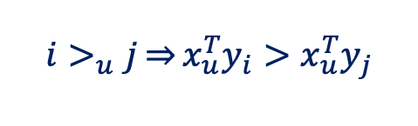
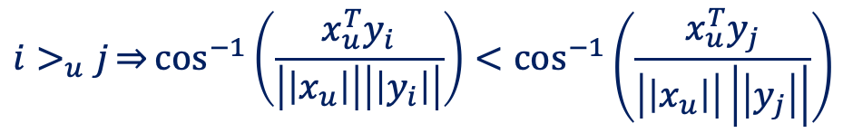
Indexable MF for Implicit Feedback
Le and Lauw, "Indexable Bayesian Personalized Ranking for Efficient Top-k Recommendation", CIKM 2017.
Bayesian Personalized Ranking (BPR)
$${i>}_{u}j\overset{⇒}{}x_{u}^{T}y_{i}>x_{u}^{T}y_{j}$$
Indexable Bayesian Personalized Ranking (IBPR)
$${i>}_{u}j\overset{⇒}{}\cos^{−1}\left(\frac{x_{u}^{T}y_{i}}{\left|\left|x_{u}\right|\right|\left|\left|y_{i}\right|\right|}\right)<\cos^{−1}\left(\frac{x_{u}^{T}y_{j}}{\left|\left|x_{u}\right|\right|\left|\left|y_{j}\right|\right|}\right)$$
Angular distance kernel is compatible with inverted index, spatial index and LSH

Slide 25
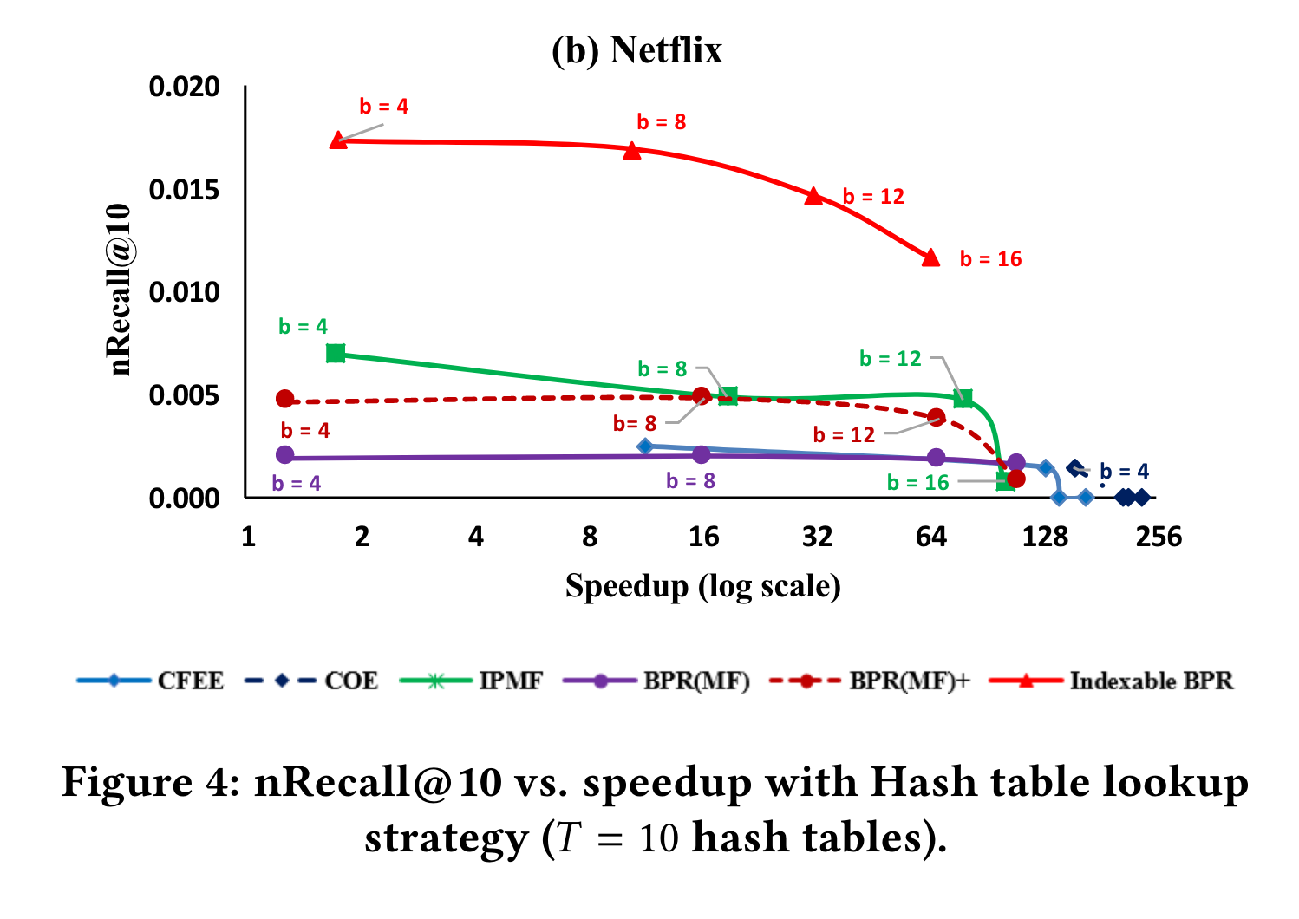
Indexable MF for Implicit Feedback
Le and Lauw, "Indexable Bayesian Personalized Ranking for Efficient Top-k Recommendation", CIKM 2017.

Slide 26
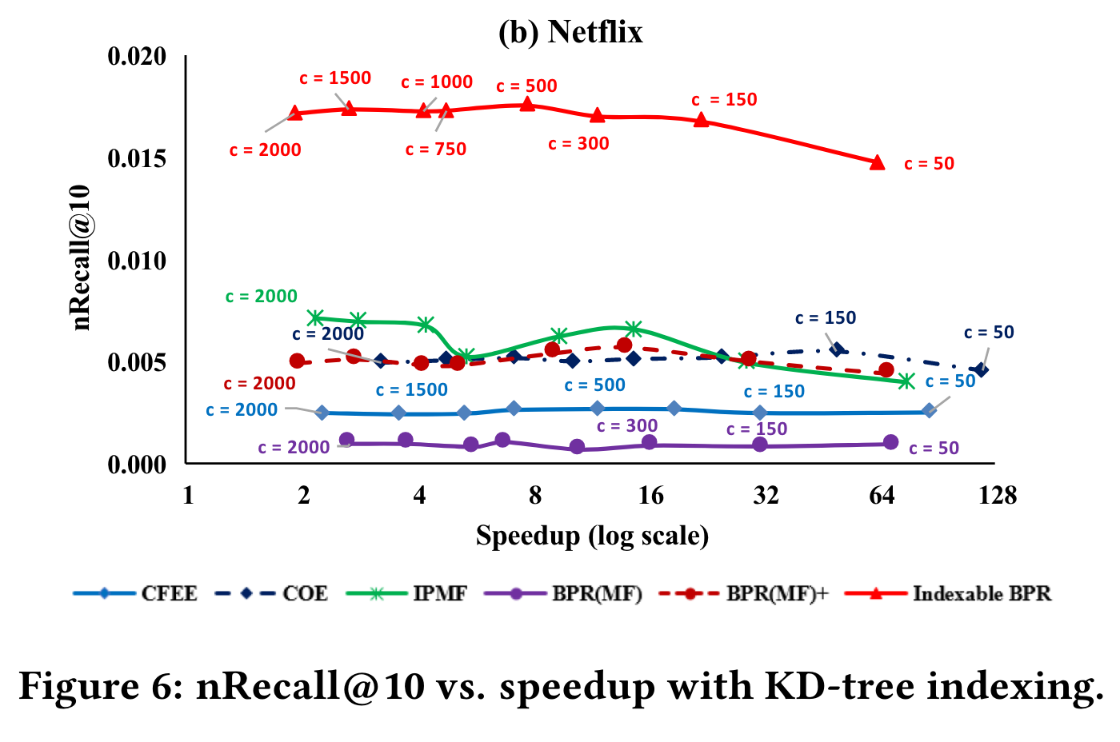
Indexable MF for Implicit Feedback
Le and Lauw, "Indexable Bayesian Personalized Ranking for Efficient Top-k Recommendation", CIKM 2017.

Slide 27
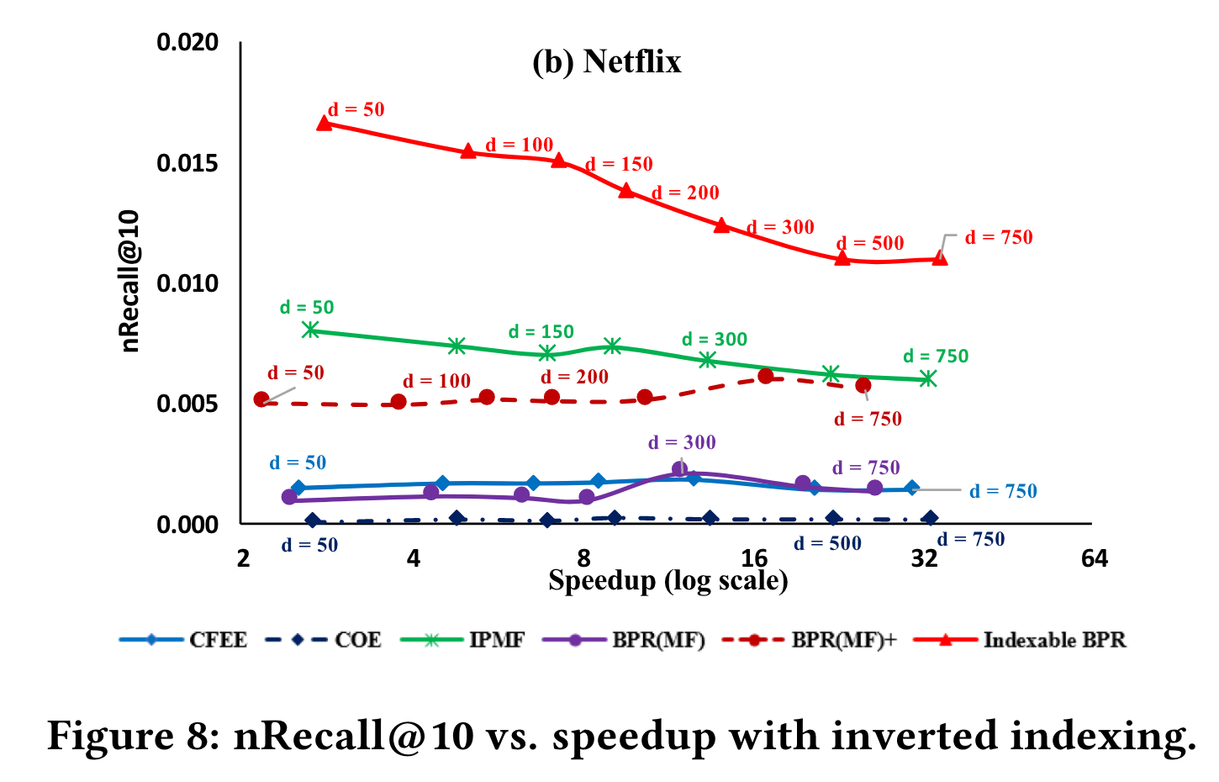
Indexable MF for Implicit Feedback
Le and Lauw, "Indexable Bayesian Personalized Ranking for Efficient Top-k Recommendation", CIKM 2017.

Slide 28
Summary
Learn user and item representations that are natively compatible with indexing in the first place
Euclidean Embedding
Indexable MF
Change inner-product formulation to one based on Euclidean distance
Compatible with spatial index and L2LSH
Keep inner-product formulation, but ensure native indexability
Compatible with spatial index, L2LSH, SRP-LSH, inverted index
Variants for explicit (rating) and implicit (ranking) feedback

